Slide 1

Week 3: Divide and Conquer
CSIE 2136 Algorithm Design and Analysis, Fall 2015
http://www.csie.ntu.edu.tw/~ada/
Hsu-Chun Hsiao

Slide 2
Housekeeping
HW1 deadline 10/2 (Mon.) 12:00
Due to class rescheduling, you’re allowed to skip minihw#2
You can still submit it as a practice
補課方案：
方案一：星期四下午14:20-17:20 請去聽蔡老師的課，上課地點會另行公布，請留意課程網站
方案二：星期六早上10-12補課，我會快速cover本週投影片的內容，上課地點會另行公布，請留意課程網站
方案三：如果方案一二都不行的話，本週四17:00-18:00，週五下午16:00-18:00，我會在我的辦公室(R511)讓同學問問題

Slide 3
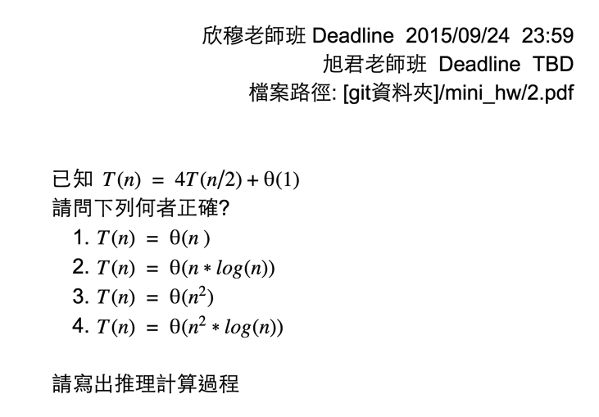
Mini-homework 2 (not required)
https://docs.google.com/document/d/1ry5VV-WlDalVZiaekZW8pCu1e0hfSh-uL-86tCLPqKU
Notes:
https://docs.google.com/document/d/1ry5VV-WlDalVZiaekZW8pCu1e0hfSh-uL-86tCLPqKU/edit

Slide 4
Agenda for this week
Recurrence (遞迴)
Divide and Conquer (分治法)
Example #1: Tower of Hanoi (河內塔)
Example #2: Merge sort (合併排序法)
Example #3: Maximum subarray (最大子序列)
How to solve recurrences
Example #4: Find the closest pair of points (最近點對問題)
Example #5: Matrix multiplication (矩陣相乘)

Slide 5
How to Solve Recurrence
Textbook Chapter 4.3-4.5

Slide 6
How to solve recurrence relations?
Substitution method (取代法)
Make a guess and then prove by mathematical induction
Recursion-tree method (遞迴樹法)
Expand the recurrence into a tree and sum up the cost
Master method (套公式大法 or 大師法)
Apply master theorem to a specific form of recurrences
Useful simplification tricks
Ignore floors and ceilings
Assume base cases are constant (for small n)

Slide 7

Substitution method (取代法)
Guess the form of the solution
Verify by mathematical induction (數學歸納法)
Solve for constants
If the guess is proven wrong, go back to Step 1
Prove O and Ω separately
數學歸納法的常見形式
證明此命題對 n = 1 成立
證明若此命題對 n = m 成立，則它在 n = m + 1 時也成立
=>此命題對所有正整數n都成立

Slide 8
Example of substitution method
Our guess
⬄ Exists positive constants n₀ and c, s.t. for all n > n₀,
也就是我們要找出一組c和n₀的解

Slide 9
Example of substitution method
Claim:
Exists positive constants n₀ and c, s.t. for all n ≥ n₀,
Proof: 使用歸納法證明並找出一組c和n₀
To satisfy initial condition when n = 1,
=> T(n) = 1 ≤ cn³
=> c ≥ 1

Slide 10
Example of substitution method
Claim:
Exists positive constants n₀ and c, s.t. for all n ≥ n₀,
Proof: 使用歸納法證明並找出一組c和n₀
Suppose T(n) ≤ cn³ for n = m-1, m-2, …
When n = m,
T(n) = 4T(n/2) + n
≤ 4c(n/2)³ + n
= cn³/2 + n
= cn³ - (cn³/2 - n)
≤ cn³
(cn³/2 – n) ≥ 0
E.g., c ≥ 2, n ≥ 1
Hence, we can set c = 2, n₀ = 1

Slide 11
Can we get a tighter upper bound?
Our guess
⬄ Exists positive constants n₀ and c, s.t. for all n > n₀,
也就是我們要找出一組c和n₀的解

Slide 12
A tighter bound
Our guess:
Claim:
Exists positive constants n₀ and c, s.t. for all n ≥ n₀,
Proof: 使用歸納法證明並找出一組c和n₀
Suppose T(n) ≤ cn² for n = m-1, m-2, …
When n = m,
T(n) = 4T(n/2) + n
≤ 4c(n/2)² + n
= cn² + n
証不出來…Orz 猜錯了？還是推導錯了？
沒猜錯 推導也沒錯
這是取代法的小盲點

Slide 13
Fixing wrong substitution
Our guess:
Strengthen the inductive hypothesis by subtracting a low-order term
Proof: 使用歸納法證明並找出一組c₁, c₂和n₀
Suppose T(n) ≤ c₁n² - c₂n for n = m-1, m-2, …
When n = m,
T(n) = 4T(n/2) + n
≤ 4(c₁(n/2)² - c₂n/2) + n
= c₁n² - c₂n - (c₂ -1)n
≤ c₁n² - c₂n
(c₂ -1)n ≥ 0
E.g., c₂ ≥ 1, n ≥ 0

Slide 14
Initial conditions
歸納法成立的另一要素：初始條件需成立
When n = 1 and c₂ ≥ 1, pick a big enough c₁
s.t. T(n) = 1 ≤ c₁n² - c₂n
E.g., c₁ ≥ 1 + c₂
Hence, we can set c₁ = 2, c₂ = 1, n₀ = 1

Slide 15
Useful tricks
Strengthen the inductive hypothesis by subtracting a low-order term
Change variables
E.g.,
Change variable: let k = logn, n=2^{k}
Change variable again: let S(k) = T(2^{k})
Solve recurrence
➔
➔

Slide 16
Recursion-tree method (遞迴樹法)
Expand a recurrence into a tree
Sum up the cost of all nodes as an educated guess
Verify the guess as in the substitution method
Advantages
Promote intuition
Generate good guesses for the substitution method

Slide 17
Example of recursion tree
Solve:
T(n) = 所有節點的和

Slide 18
Example of recursion tree
Solve:
T(n) = 所有節點的和
Notes:
樹的節點全部加起來等於T(n)

Slide 19
Example of recursion tree
Solve:
T(n) = 所有節點的和

Slide 20
Example of recursion tree
Solve:
T(n) = 所有節點的和
……
……
+
……
……
T(n) ≤

Slide 21
Geometric series (幾何數列 or 等比數列)
T(n) ≤
Use induction to prove correctness

Slide 22
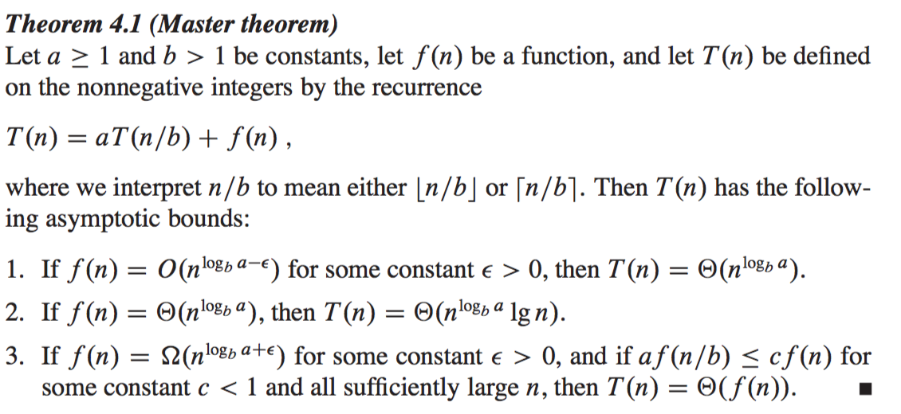
Master method (套公式大法or大師法)
只有這種形式才能套master theorem

Slide 23
Understanding master theorem via recursion tree
Solve:
a
……
a
……
h=log_{b}n+1
……
……
……
+
Total = ?
Notes:
k = # of levels = log_{b}n
a_{i} = # of subproblems at level i
n/b_{i} = size of each subproblem at level I
用遞迴樹的方法說明master theorem

Slide 24
Three cases
a ≥ 1, the number of subproblems
b > 1, the factor by which the subproblem size decreases
f(n) = work to divide/combine subproblems
比較 和 ，有三種可能的情況：
Case 1: grows polynomially slower than
Case 2: and grow at similar rates
Case 3: grows polynomially faster than
Notes:
Case 1: 發散數列 f(n)是什麼不重要 最後這一項主宰了T(n)的大小
Case 2: 遞迴樹的每一層的值都差不多 所以T(n)會被樹的高度影響 那因為兩項差不多，所以也可以不管f(n)實際上是什麼，就說T(n)會被最後一項影響
Case 3: f(n)長得比較快 那麼T(n)就由f(n)決定了 a b 不重要

Slide 25
Case 1: Total cost dominated by cost of leaves
grows polynomially slower than
Ex:
a
……
a
……
……
……
……
Notes:
a, b, f(n), T(1)

Slide 26
Case 1: Total cost dominated by cost of leaves
Ex:
T(n) =
Same as applying master theorem:
E.g., setting ε = 0.1 satisfies this condition
F(n) = n, n^{logba} = n^{1.58}

Slide 27
Case 2: Total cost evenly distributed among levels
and grow at similar rates
Ex:
a
……
a
……
……
……
……

Slide 28
Case 2: Total cost evenly distributed among levels
Ex:
T(n) =
Same as applying the master theorem:

Slide 29
Case 3: Total cost dominated by cost of root
grows polynomially faster than
Ex:
a
……
a
……
……
……
……

Slide 30
Case 3: Total cost dominated by cost of root
Ex:
Same as applying the master theorem:
Notes:
紅框：證明需要
直覺：展開後的每一層要比之前那層小 所以才會是root dominates
正則條件

Slide 31
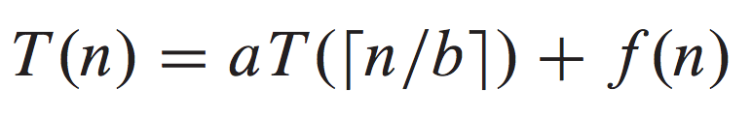
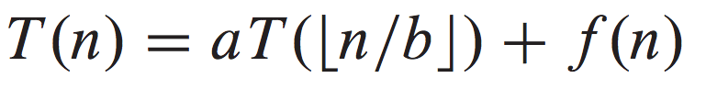
Floors and ceilings
We ignore them so far
Master theorem can be extended to recurrences with floors and ceilings
Textbook Chapter 4.6.2

Slide 32
Exercise:
Case 1:
Notes:
自己算算看

Slide 33
Exercise:
Case 2:
Notes:
自己算算看

Slide 34
Exercise:
Case 3: and
Notes:
自己算算看

Slide 35
More exercise:
Notes:
自己算算看
a < 1, master theorem doesn’t apply

Slide 36
Example #4: closest pair of points Problem (最近點對問題)
Textbook Chapter 33.4
Section 5.4 of Algorithm Design by Kleinberg & Tardos

Slide 37

海妖的詛咒
只要相鄰最近的兩條海盜船，船員就會無可救藥地
想要與對方PK海帶拳…

Slide 38
Finding closest pair of points
Given a set of points {p₁,…, p_{n}} find the pair of points {p_{i}, p_{j}} that are closest together
Closest = with the smallest Euclidean distance
Euclidean distance between p_{i} = (x_{i}, y_{i}) and p_{j} = (x_{j}, y_{j}):
Brute force: checks all pairs and returns the closest
Let’s first consider this problem in one-dimensional space
Θ(n²) distance calculations
Notes:
暴力法

Slide 39
1D closest pair of points
Can be solved in Θ(nlogn) via sorting
Scan the sorted points to find the closest pair in one pass
若p和q是距離最近的點對，p和q之間一定沒有其他點
=>檢查相鄰的點就夠了
Can we generalize this to higher dimensions?

Slide 40
2D closest pair of points: attempt #1
Rule X: sort by x-coordinate and consider nearby points
Rule Y: sort by y-coordinate and consider nearby points
Closest pair in 2D
Rule X
Rule Y

Slide 41
2D closest pair of points: attempt #2
Divide into 4 regions

Slide 42
2D closest pair of points: attempt #2
Divide into 4 regions
Points may distribute unevenly => hard to describe in recursion

Slide 43
2D closest pair of points: divide-and-conquer
Divide: divide points evenly along x-coordinate
Conquer: find closest pair in each region recursively
Combine: find closet pair with one point in each region, and return the best of three solutions
L
left-min = 10
cross-min = 7
right-min = 13

Slide 44
Find closest pair across two regions
考慮所有的跨區點對，找出其中距離最小的？
n/2 * n/2 種組合 ☹
要考慮的組合還是太多了，有沒有辦法縮小搜尋範圍？
L
left-min = 10
cross-min = 7
right-min = 13

Slide 45
Find closest pair across two regions
Observation 1: only need to consider points within δ of the cut, δ = min{left-min, right-min}
不在灰色長條區域內的跨區點對，兩點的距離一定比δ大！
不用考慮距離≥δ的跨區點對，因為這些點對不可能是最終的答案
δ
δ
縮小搜尋範圍！☺
left-min = 10
cross-min = 7
right-min = 13

Slide 46
Find closest pair across two regions
Observation 1: only need to consider points within δ of the cut, δ = min{left-min, right-min}
Observation 2: only need to consider pairs within δx2δ blocks
任一距離<δ的跨區點對, 一定落在某個δx2δ的區塊中
δ
δ
搜尋範圍越來越小了☺
但是…要是很倒霉，所有的點都聚集在某個δx2δ區塊內怎麼辦？☹
δ
<δ

Slide 47
Find closest pair across two regions
Observation 1: only need to consider points within δ of the cut, δ = min{left-min, right-min}
Observation 2: only need to consider pairs within δx2δ blocks
任一距離<δ的跨區點對, 一定落在某個δx2δ的區塊中
Observation 3: 任一個δx2δ區塊最多包含8個點
Claim: 每個δ/2 x δ/2的方格至多包含1個點
反證法：若左(右)邊平面上有某個方格包含多個點，那麼左(右)邊平面的最近點距離<δ。跟δ = min{left-min, right-min}矛盾。
δ
δ
同個方格裡的點距離<δ
如果有距離<δ的同區點對，之前遞迴的時候就該找出來了。
矛盾！
得知每個小方格至多包含1個點！
δ/2
δ/2

Slide 48
Find closest pair across two regions
Observation 1: only need to consider points within δ of the cut, δ = min{left-min, right-min}
Observation 2: only need to consider pairs within δx2δ blocks
任一距離<δ的跨區點對, 一定落在某個δx2δ的區塊中
Observation 3: 任一個δx2δ區塊最多包含8個點
δ
δ
p_{i+5}
Find-closet-pair-across-regions
以y坐標為準，排序灰色區域內的點
對每個排序後的點 p_{i}，計算與p_{i+1}, p_{i+2}, …, p_{i+7}的距離
回傳最小距離
p_{i+4}
p_{i+3}
=> At most 7 distance calculations needed according to Observation 3
p_{i+2}
p_{i}

Slide 49
Closest-Pair(P)
//termination condition (base case)
If |P|≤3, brute-force finding closest pair and return it
//Divide
Find a vertical line L s.t. both left and right planes ____contain half of the points
//Conquer (by recursion)
left-pair <- Closest-Pair(points in the left)
right-pair <- Closest-Pair(points in the right)
left-min <- Distance(left-pair)
right-min <- Distance(right-pair)
//Combine
δ = min{left-min, right-min}
Remove points that are δ or more away from L //Observation 1
Sort remaining points by y-coordinate into p₀, …, p_{k}
For point p_{i}:
____Compute distances with p_{i+1}, P_{i+2}, …, p_{i+7}
____//at most 7 distance calculations based on Observation 3
____Update δ if a closer pair is found
Return the closest pair

Slide 50

Running time analysis
 |  | Running time
Base case (n≤3) |  | O(1)
Recursive case (n>3)
 | Divide | O(nlogn)
 | Conquer | 2T(n/2)
 | Combine | O(nlogn)
看到平方， 表示震怒
sorting

Slide 51
Preprocess
Sorting inside the recursive case is too costly
Alternative:
Sort points in P by x- and y-coordinate at beginning
P_{x}
P_{y}
Given sorted points P_{x} and P_{y}, we can divide each of them into two set of sorted points in linear time s.t.
P_{x} -> P_{xL} and P_{xR}
P_{y} -> P_{yL} and P_{yR}
P_{xL} and P_{yL} are in the left region
P_{xR} and P_{yR} are in the right region

Slide 52

Running time analysis
 |  | Running time
Preprocess (sort by x, y) |  | O(nlogn)
Base case (n≤3) |  | O(1)
Recursive case (n>3)
 | Divide | O(n)
 | Conquer | 2T(n/2)
 | Combine | O(n)
Because points are pre-sorted, both Divide and Combine can be done in linear time

Slide 53

O(n) time algorithm
Taking advantage of randomization
For more information, see
Chapter 13.7 of Algorithm Design by Kleinberg & Tardos
Samir Khuller and Yossi Matias. 1995. A simple randomized sieve algorithm for the closest-pair problem. Inf. Comput. 118, 1 (April 1995), 34-37.

Slide 54
Example #5: Matrix Multiplication (矩陣相乘)
Textbook Chapter 4.2

Slide 55
Recall how to multiply two matrices (Appendix D.1)
B
4 | 0 | -1
1 | -2 | 3
1 | 2
-5 | 0
-4
A
-20

Slide 56
Recall how to multiply two matrices (Appendix D.1)
A是n by r矩陣, B是r by m矩陣
c_{uv} = the u^{th}-row and v^{th}-column entry of C
# of multiplications to compute each entry in C using the above formula = ?
C has nm entries, and computing each entry requires r multiplications.
Hence, the running time is
For simplicity, we will assume n = m = r = power of 2 from now on.

Slide 57
Fast matrix multiplication problem
Can we design MatrixMultiply(A, B) s.t. its running time is lower than ?
Note: The best lower bound known is
Why?
Notes:
must fill in n2 elements of the product matrix

Slide 58
用Divide-and-Conquer加速矩陣相乘 Attempt#1: 切成四等分
Running time = Θ(1)
Divide each n by n matrix into four n/2 by n/2 submatrices
B
矩陣的性質保證以下四個等式成立：
B₁₁
B₁₂
B₂₁
B₂₂
A₁₁
A₁₂
C₁₁
C₁₂
A
A₂₁
A₂₂
C₂₁
C₂₂

Slide 59
用Divide-and-Conquer加速矩陣相乘 Attempt#1: 切成四等分
Conquer by recursion
Recursive case: n>1時，計算
MatrixMultiply(n/2, A₁₁, B₁₁), MatrixMultiply(n/2, A₁₂, B₂₁)
MatrixMultiply(n/2, A₁₁, B₁₂), MatrixMultiply(n/2, A₁₂, B₂₂)
MatrixMultiply(n/2, A₂₁, B₁₁), MatrixMultiply(n/2, A₂₂, B₂₁)
MatrixMultiply(n/2, A₂₁, B₁₂), MatrixMultiply(n/2, A₂₂, B₂₂)
總共呼叫了8次MatrixMultiply, 輸入的矩陣大小為n/2
Running time = 8T(n/2)

Slide 60
用Divide-and-Conquer加速矩陣相乘 Attempt#1: 切成四等分
Combine
C₁₁ = MatrixMultiply(A₁₁, B₁₁) + MatrixMultiply(A₁₂, B₂₁)
C₂₁ = MatrixMultiply(A₁₁, B₁₂) + MatrixMultiply(A₁₂, B₂₂)
C₂₁ = MatrixMultiply(A₂₁, B₁₁) + MatrixMultiply(A₂₂, B₂₁)
C₂₂ = MatrixMultiply(A₂₁, B₁₂) + MatrixMultiply(A₂₂, B₂₂)
Combine C₁₁, C₁₂, C₂₁, C₂₂ into C
四次矩陣加法，每個小矩陣有n²個元素
Running time = Θ(n²)
C₁₁
C₁₂
C =
C₂₁
C₂₂

Slide 61
用Divide-and-Conquer加速矩陣相乘 Attempt#1: 切成四等分
Running time = Θ(1)
Base case
n=1時，C = MatrixMultiply(n, A, B) 只需1次數值乘法
MatrixMultiply(n, A, B)
//base case
if n = 1
___return AB
//recursive case
Divide A and B into n/2 by n/2 submatrices
C₁₁ <- MatrixMultiply(A₁₁,B₁₁) + MatrixMultiply(A₁₂,B₂₁)
C₂₁ <- MatrixMultiply(A₁₁,B₁₂) + MatrixMultiply(A₁₂,B₂₂)
C₂₁ <- MatrixMultiply(A₂₁,B₁₁) + MatrixMultiply(A₂₂,B₂₁)
C₂₂ <- MatrixMultiply(A₂₁,B₁₂) + MatrixMultiply(A₂₂,B₂₂)
return C

Slide 62
Running time analysis
 |  | Running time
Base case (n=1) |  | Θ(1)
Recursive case (n>1)
 | Divide | Θ(1)
 | Conquer | 8T(n/2)
 | Combine | Θ(n²)
砍掉重練
Attempt#1

Slide 63
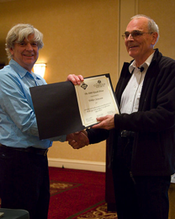
Strassen’s algorithm
Important theoretical breakthrough by Volker Strassen in 1969
Reduces the running time from Θ(n³) to Θ(n^{log27}) ≈ Θ(n^{2.807})
Its key idea is to reduce the number of recursive calls
From 8 recursive calls down to 7 recursive calls
At the cost of extra addition and subtraction operations
In 2008, Strassen was awarded the Knuth Prize for "seminal and influential contributions to the design and analysis of efficient algorithms."

Slide 64
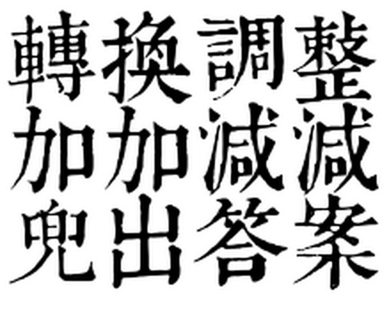

Slide 65

Strassen’s algorithm
轉換調整 加加減減 兜出答案
Intuition:
ac + ad + bc + bd = (a + b)(c + d)
4次乘法 3次加法
1次乘法 2次加法
Notes:
同樣的算式 可以有不一樣的表示方法
不同的計算順序跟grouping的方式 會需要不同的計算量

Slide 66
Strassen’s algorithm
轉換調整 加加減減 兜出答案
Divide the input matrices A and B and output matrix C into n/2 by n/2 submatrices (as before)
Create 10 matrices S₁, S₂, …, S₁₀, each of which is n/2 by n/2 and is the sum or difference of two matrices created in step 1
Using the submatrices created in step 1 and the 10 matrices created in step 2, recursively compute 7 matrix products P₁, P₂, …, P₇. Each matrix P_{i} is n/2 by n/2
Compute the desired submatrices C₁₁, C₁₂, C₂₁, C₂₂ of the result matrix C by adding and subtracting various combinations of the P_{i} matrices
Θ(1)
Θ(n²)
7T(n/2)
Θ(n²)
Notes:
使用7 次乘法
難就難在 如何發現並找到 矩陣運算中這些能重複使用的部分

Slide 67
Pseudocode
Strassen(n, A, B)
//base case
if n = 1
___return AB
//recursive case
Divide A and B into n/2 by n/2 submatrices
P1 <- Strassen(n/2, A₁₁, B₁₂-B₂₂)
P2 <- Strassen(n/2, A₁₁+A₁₂, B₂₂)
P3 <- Strassen(n/2, A₂₁+A₂₂, B₁₁)
P4 <- Strassen(n/2, A₂₂, B₂₁-B₁₁)
P5 <- Strassen(n/2, A₁₁+A₂₂, B₁₁+B₂₂)
P6 <- Strassen(n/2, A₁₂-A₂₂, B₂₁+B₂₂)
P7 <- Strassen(n/2, A₁₁-A₂₁, B₁₁+B₁₂)
C₁₁ <- P5 + P4 - P2 + P6
C₁₂ <- P1 + P2
C₂₁ <- P3 + P4
C₂₂ <- P1 + P5 - P3 - P7
return C

Slide 68
Running time analysis
 |  | Running time
Base case (n=1) |  | Θ(1)
Recursive case (n>1)
 | Divide | Θ(1)
 | Conquer | 7T(n/2)
 | Combine | Θ(n²)

Slide 69
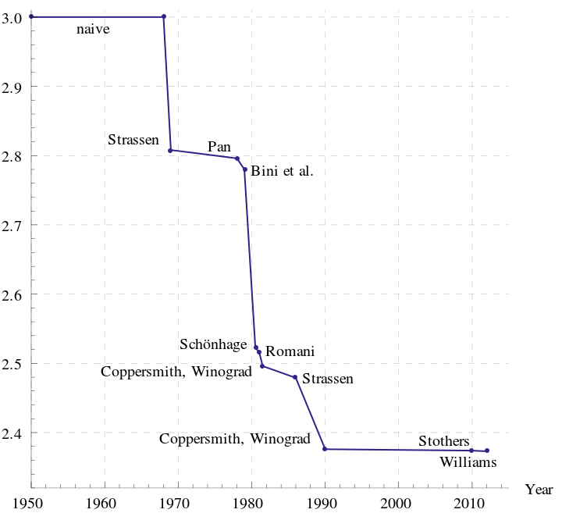
https://en.wikipedia.org/wiki/Matrix_multiplication
Θ(n^{log27})
Best algorithm so far: O(n^{2.3728639})
Notes:
Little omega
最佳表現

Slide 70
Practicability of Strassen’s algorithm
Often not the method of choice for matrix multiplication:
Larger constant factor than it in the naïve approach
Faster algorithms exist for sparse matrices
Less numerical stable than the naïve approach
Larger errors accumulate in non-integer computation due to limited precision
The submatrices formed at the levels of recursion consume space
Notes:
後兩者有被解決

Slide 71
Divide and Conquer 思路
是否適合用D&C?
當input很小時，可以直接解決小問題嗎？
若有小問題的解，可以組合成大問題的解嗎？
Overall的時間複雜度是否有比naïve方法好？
如果上述任一答案為否：
試著稍作修正或增加額外資訊
試著重新切割
放棄使用D&C
1. Divide
2. Conquer
3. Combine
Notes:
Divide and Combine的時間

Slide 72
Divide-and-Conquer may be suboptimal
Subproblems重複計算的部分太多
Naïve approach for Fibonacci:
Bottom up approach to Fibonacci:
Fibonacci(n)
if n < 2 //base case
____return 1
//recursive case
return Fibonacci(n-1) + Fibonacci(n-2)
Fibonacci(n)
if n < 2
____return 1
a[0] <- 1
a[1] <- 1
for i = 2 … n
____a[i] <- a[i-1] + a[i-2]
return a[n]
Our next topic:
Dynamic Programming
“a technique for solving problems with overlapping subproblems”
Notes:
黃金比例
DP: 空間換取時間 會重複算到的部分先存起來

